Slide 1

Reddit Analysis
To r/all…
and beyond…
Saqib Nizami

Slide 2
Key Points:
Subreddit
Topicality
self.Posts
Titlecraft

Slide 3

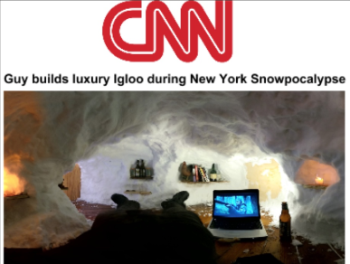
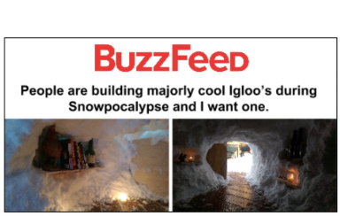
Kind of a big deal
source : https://blog.datastories.com/blog/reddit-front-page

Slide 4
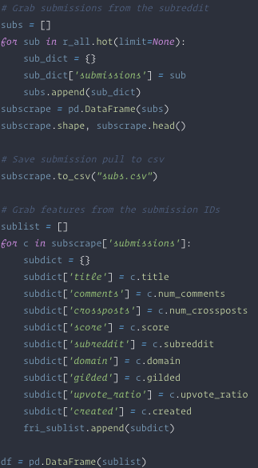
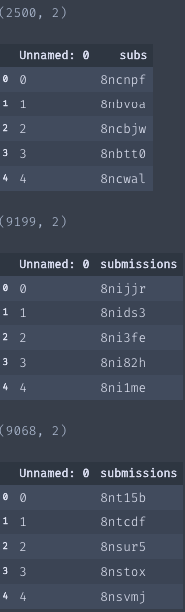
Data Scrapes
The PRAW (https://github.com/praw-dev) API wrapper interacts with the Reddit API as a good citizen.
Easily pull down submissions with a few lines of code

Slide 5
The haul
22767 submissions to r/all in the ‘hot’ category
Over 3 days: Wed-Fri May 30-June , 2018
Commenting breakdown:
25th Percentile: 11 comments
16985
50th Percentile: 31 comments
11238
75th Percentile: 86 comments
5635

Slide 6
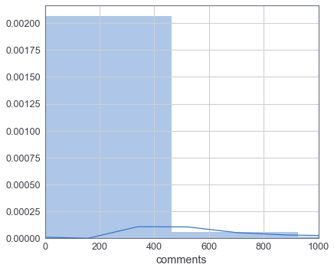
Comment distribution
Positive, right tail
Greater frequency of 300 - 500 comments

Slide 7
Baseline Accuracy
In the 50th percentile range, a failed (< 31 comments) submission was more common
Our baseline accuracy therefore is : 50.63%
What we’re looking at is a greater tendency to fail
Now, let’s see what makes a good post...

Slide 8
SubReddit Importance and RandomForests
Running all the subreddits through RandomForestClassifier returned an accuracy of 72.17%!
The chosen subreddits were used to tune to the model
Models used : RandomForest, MultinomialNB, and LogisticRegression

Slide 9
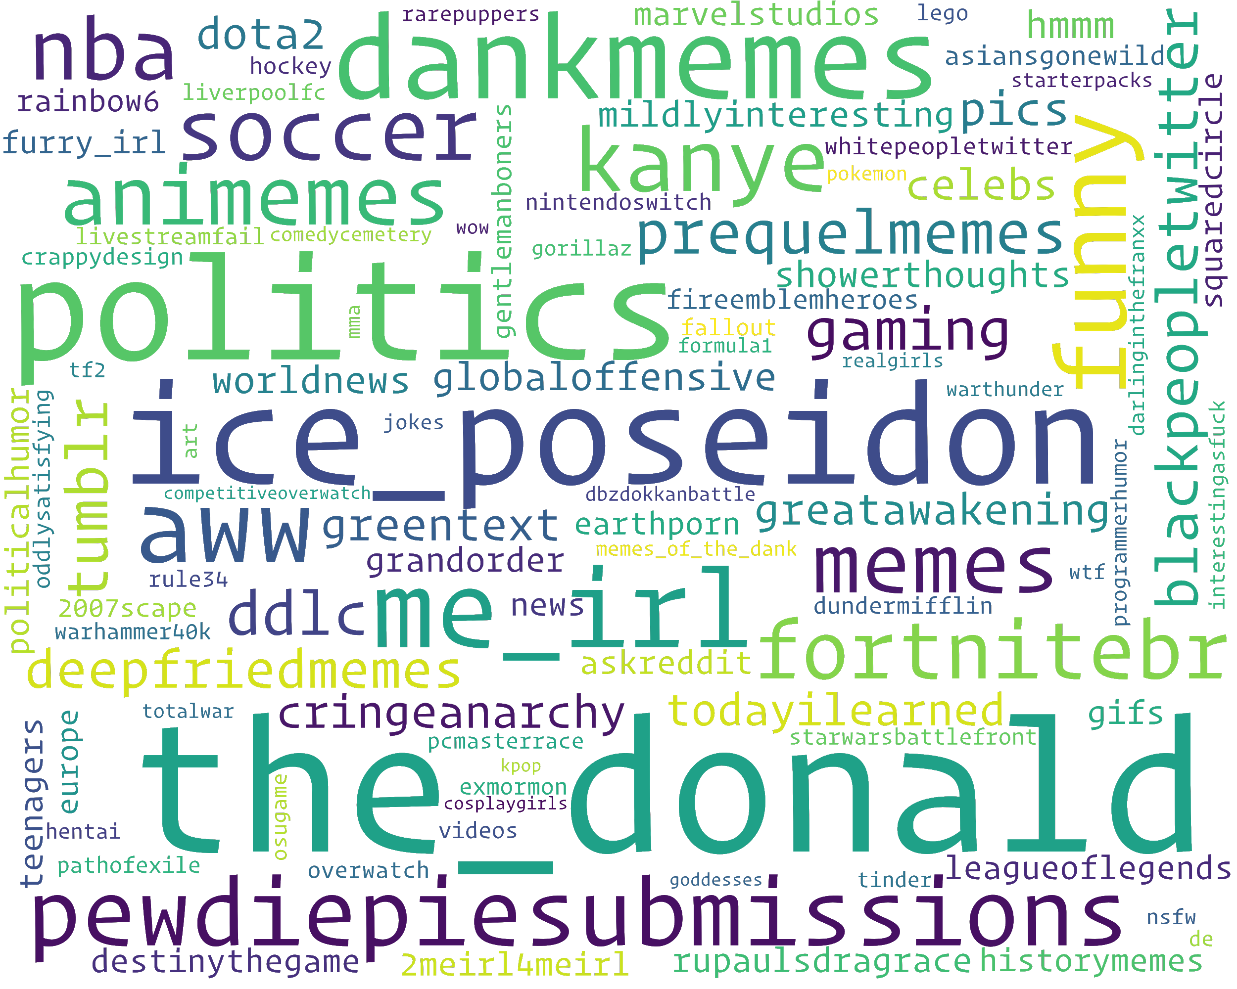
Before
Model

Slide 10
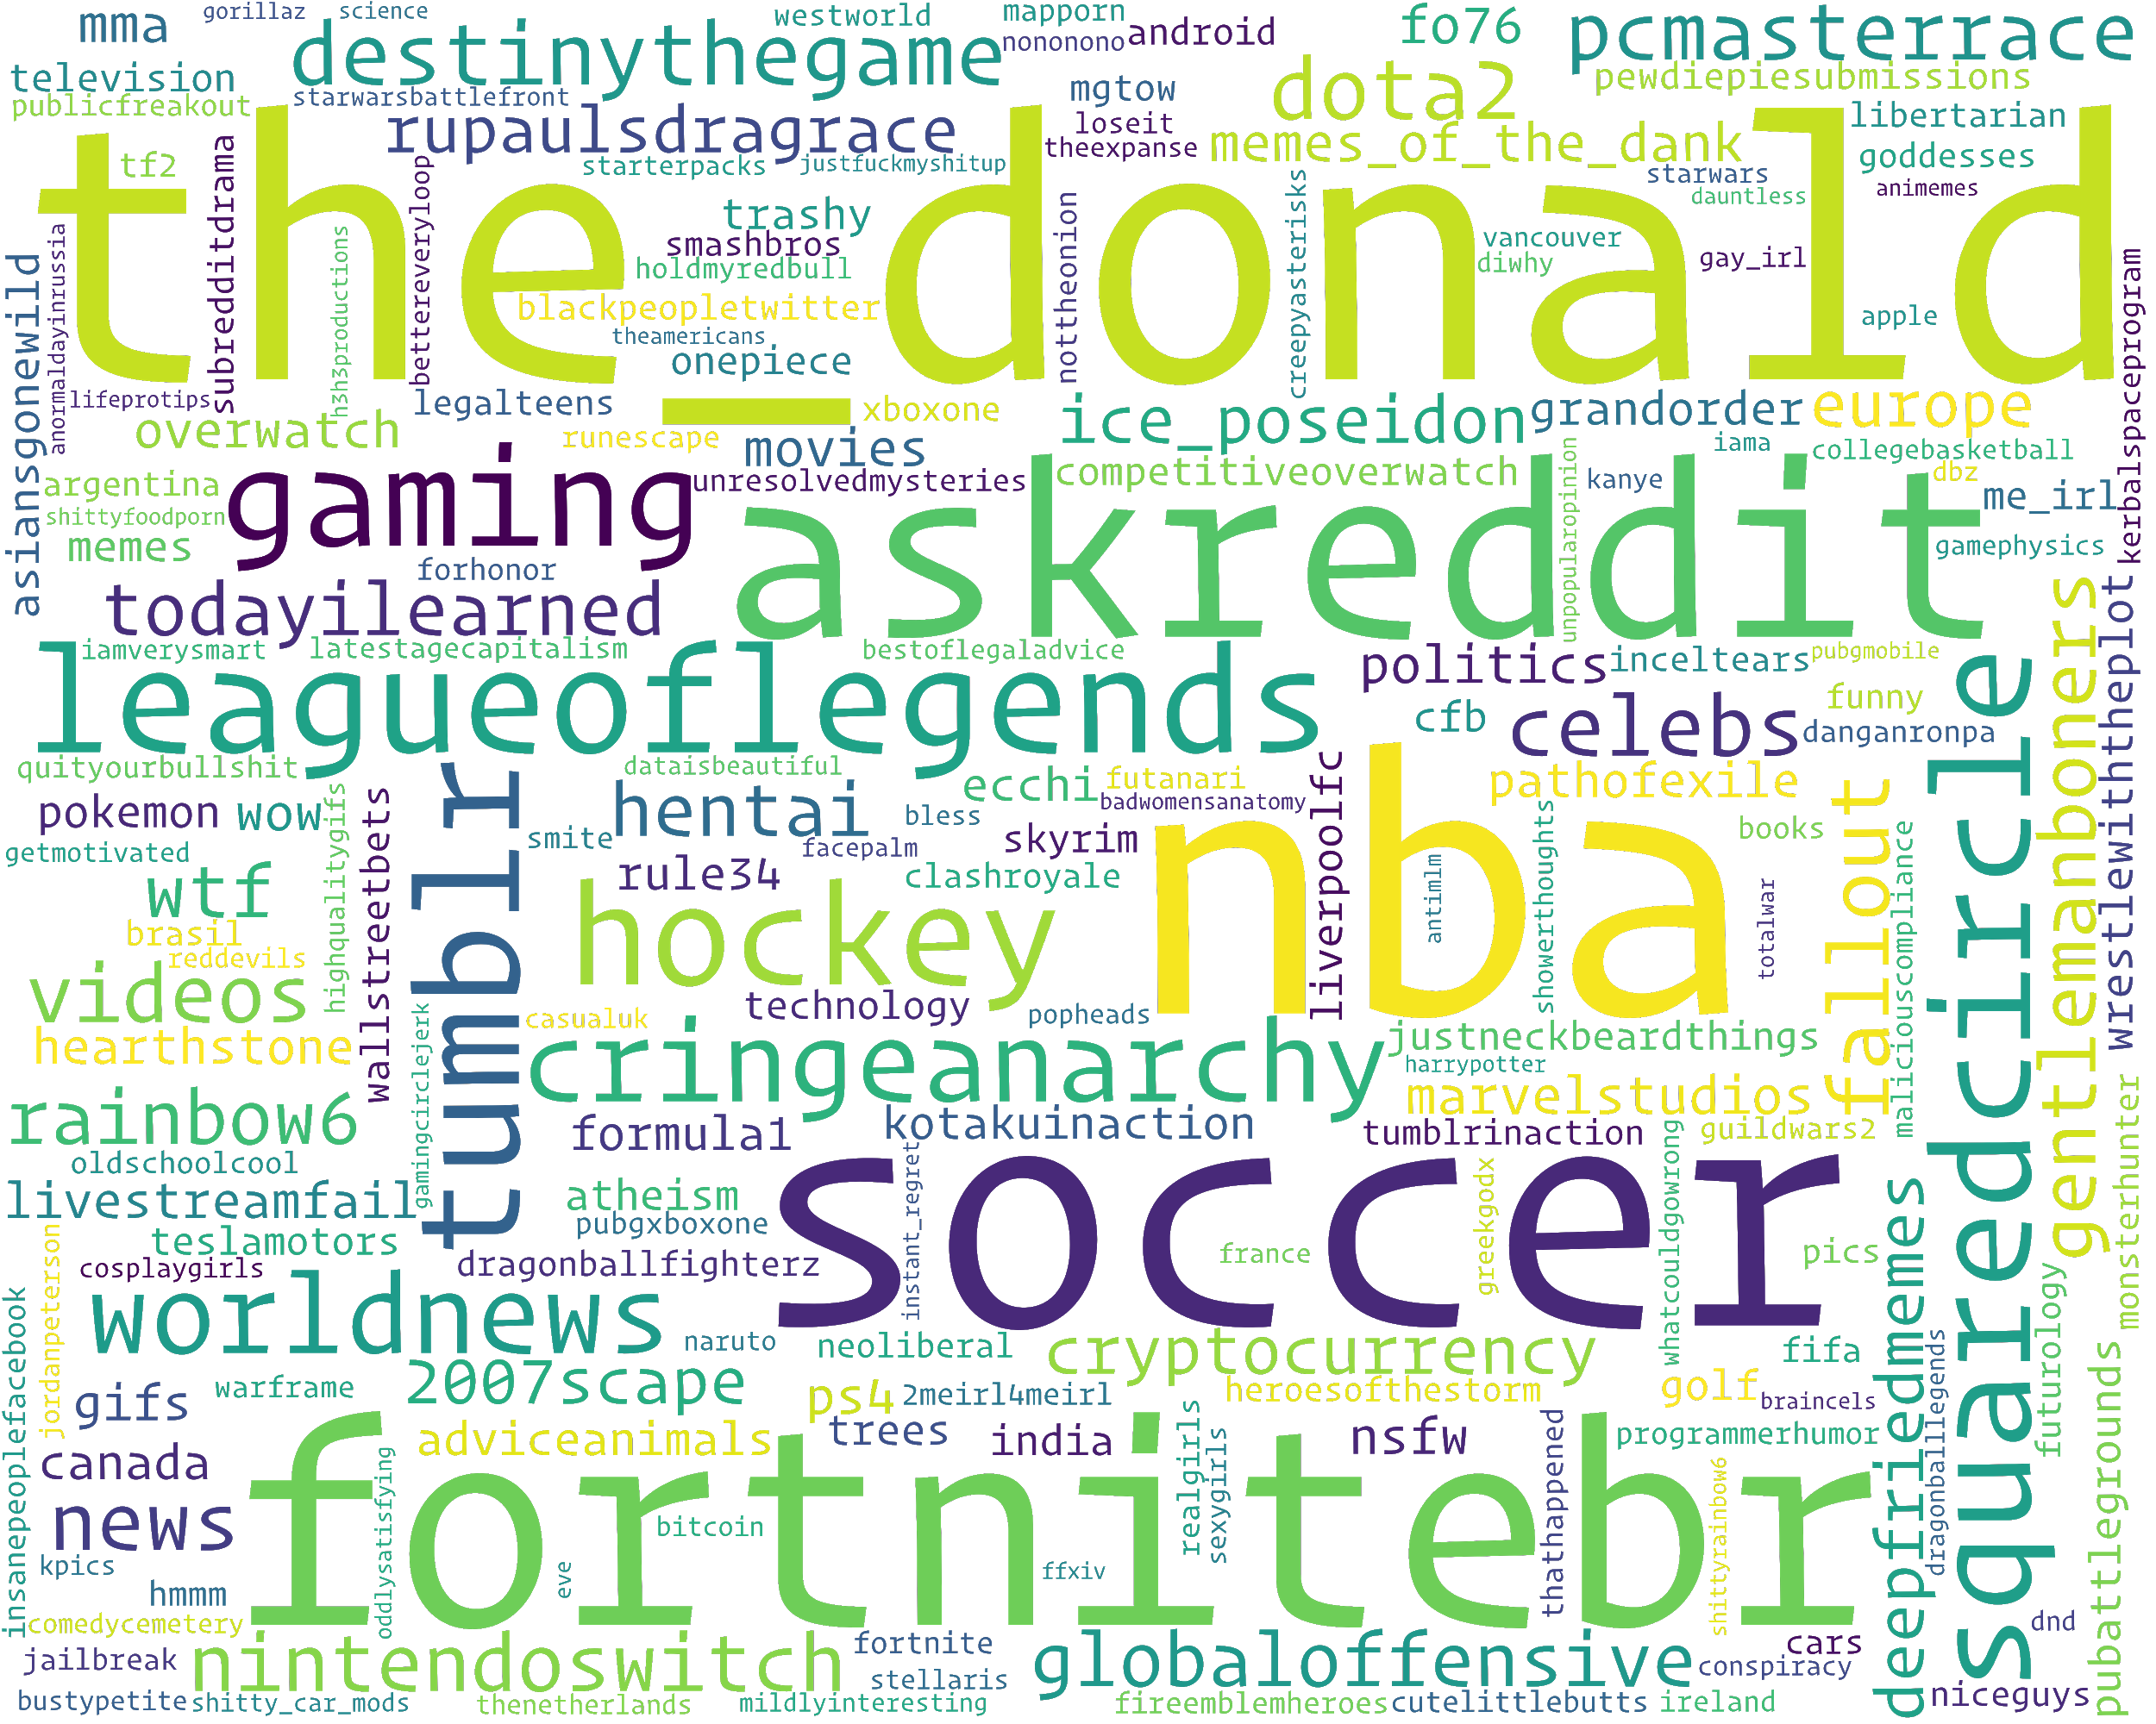
After
Model

Slide 11
Title Fight!
['year old', 'looks like', 'years ago', 'steel aluminum', 'real madrid', 'world cup', 'donald trump', 'lebron james', 'white house', 'infinity war', 'look like', 'don know', 'trade war', 'best friend', 'fallout 76', 'dinesh souza', 'spider man', 'aluminum tariffs', 'social media', 'jr smith']
[('trump like talking toddler', 8), ('faked 258 000 breath', 6), ('meeting trump like talking', 6), ('police faked 258 000', 5), ('feigen tucker played game', 5), ('tucker played game root', 5),

Slide 12
New Features!
"comment_ratio” :Failed posts had comment to score ratios < 0.68
"is_self” : Self posts comprised 10% of the successful subset

Slide 13
Subreddit
Hitting the right group inc. trending likelihood
Topicality
Discussions of news items
self.Posts
ꜛ participation
Titlecraft
Cursory analysis indicates that incendiary titles might be better. Need sentiment analysis

